Slide 1

ESD PROJECT
( SECURITY, SAFETY & SURVEILLANCE )
SAFETY AND SECURITY OF THE ATM PROCESS WITH BIOMETRIC APPLICATIONS
YEAR - 2022

Slide 2

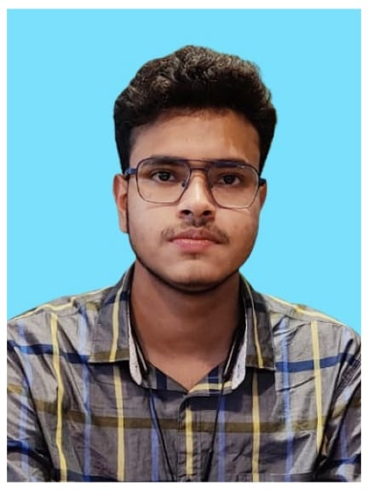
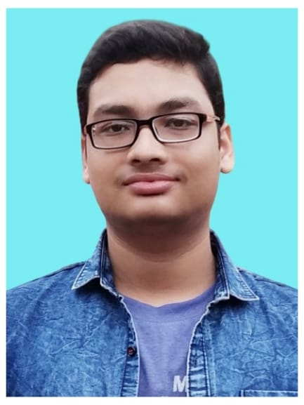
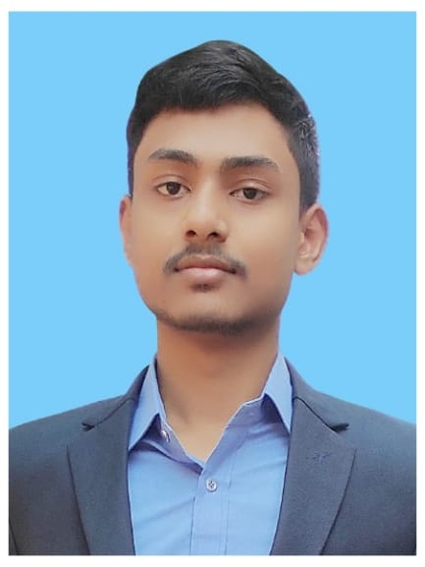
T E A M (2021131)
Biswadip Ghosh
201001001148
Kaustav Sahana
201001001008
Sayan Chakraborty
201001001024
Supriya Dey
201001001014
We are a team of Four. We wanted to do something new to secure the ATM Banking Process of our Country India. We wanted our biometric authentication power in this project. We also Wanted to continue our project and give a success to it with the help of our Mentors.
So, Let’s see what we can do……………………

Slide 3

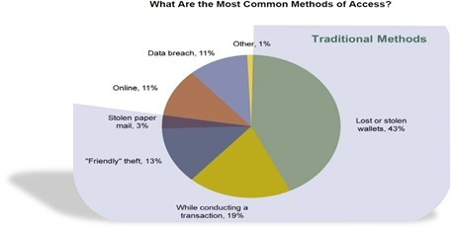
PROBLEM STATEMENT
ATM card frauds.
Use of ATM card duplicators.
Card sharing by family and friends.
Inability to trace the wrongful users.
ATM PINs can be shared on phone or recorded using secret cameras.

Slide 4
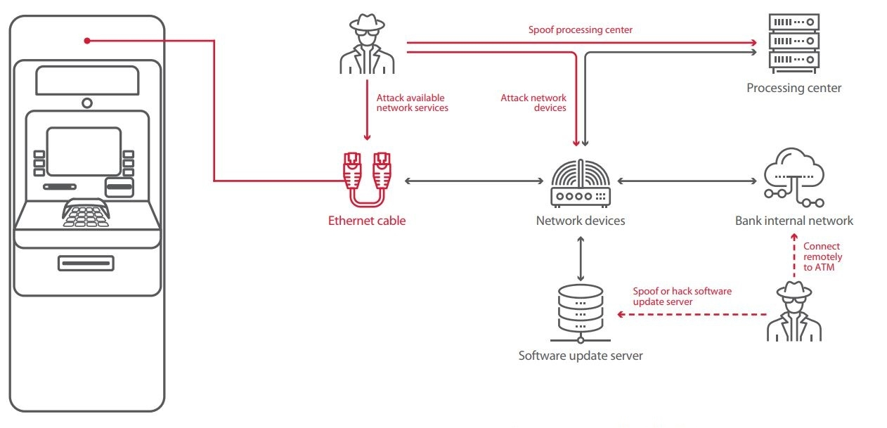

Slide 5

MISSION STATEMENT
Biometric Authentication : Fingerprint, Iris, Face……………..We can use anyone.
Multifactor Authentication : Card + PIN + Biometric Verification + OTP Verification
Online or Offline Authentication using Smart Cards.
Card less Authentication.

Slide 6

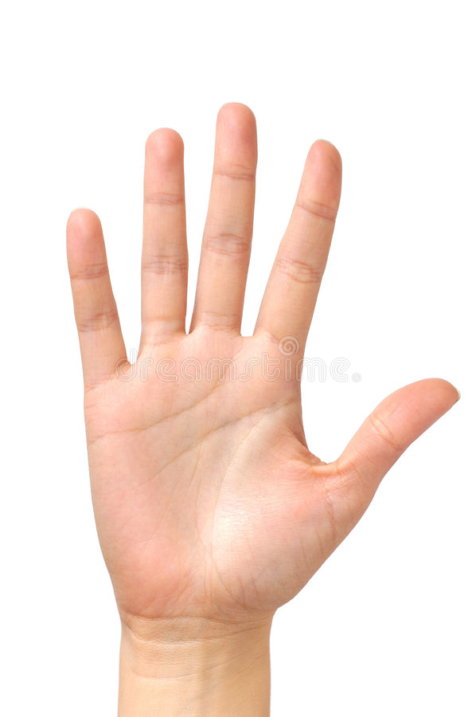
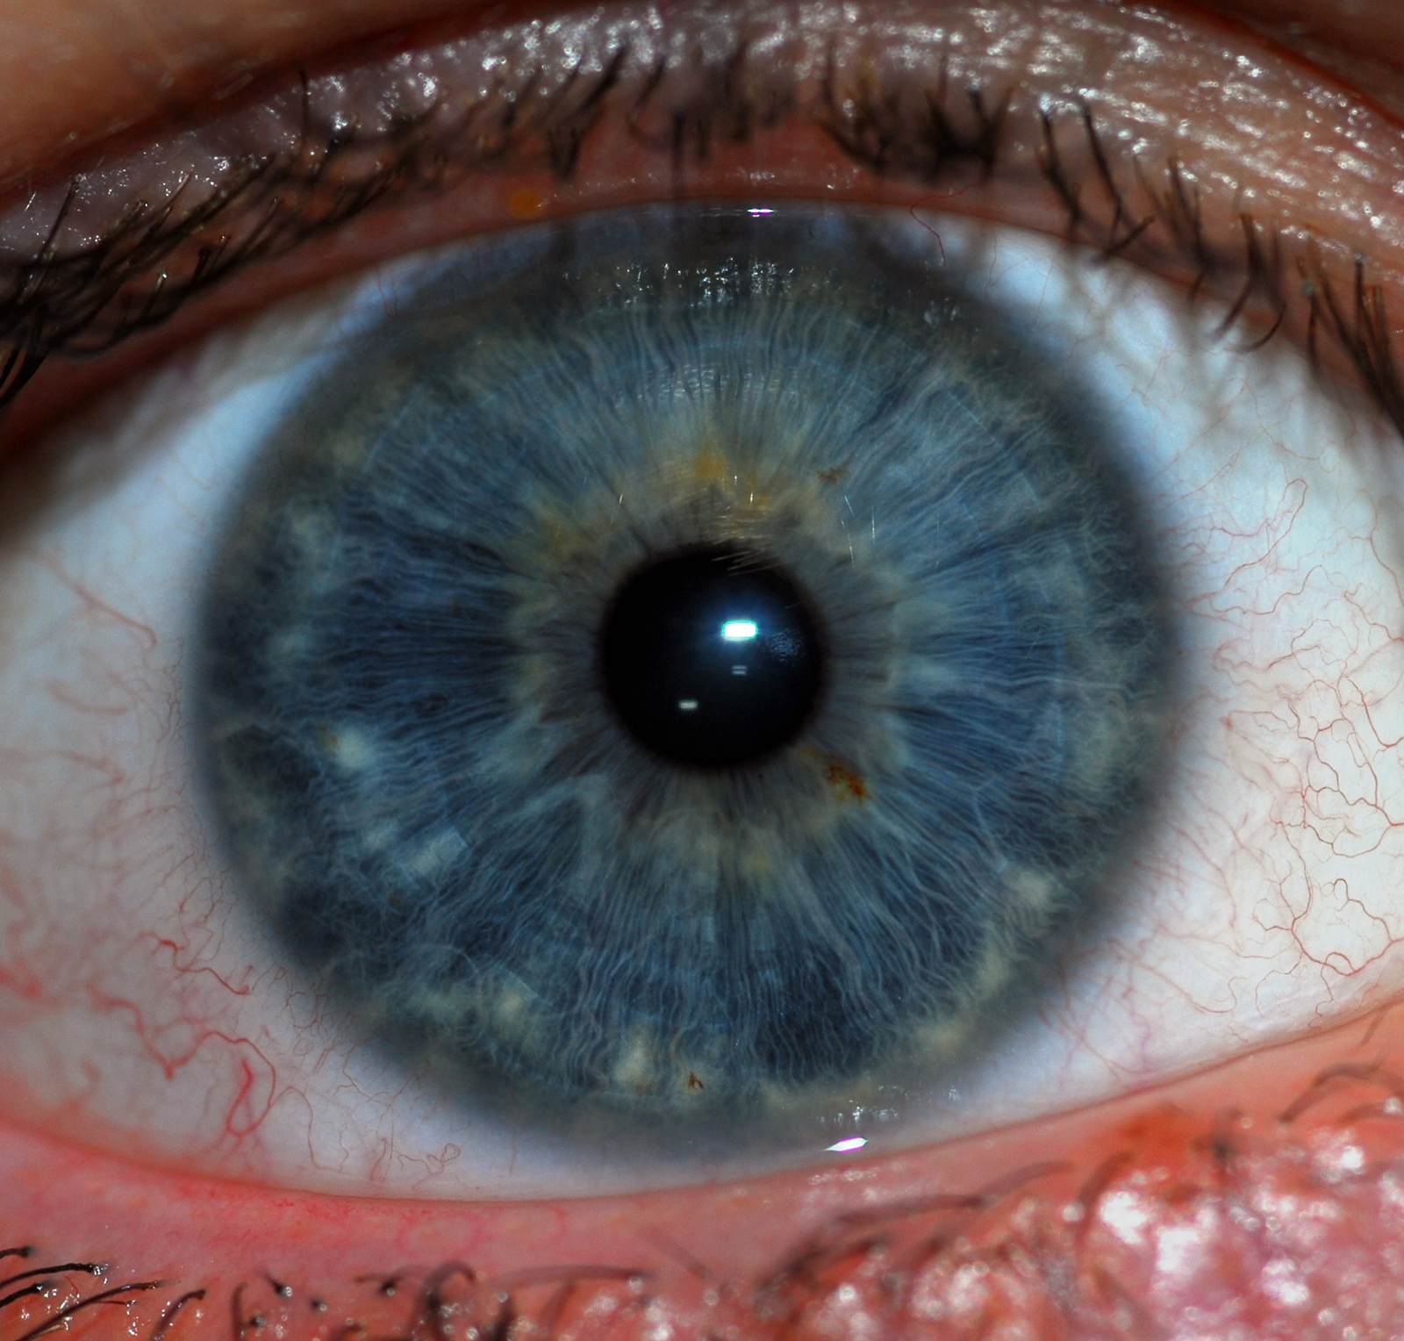
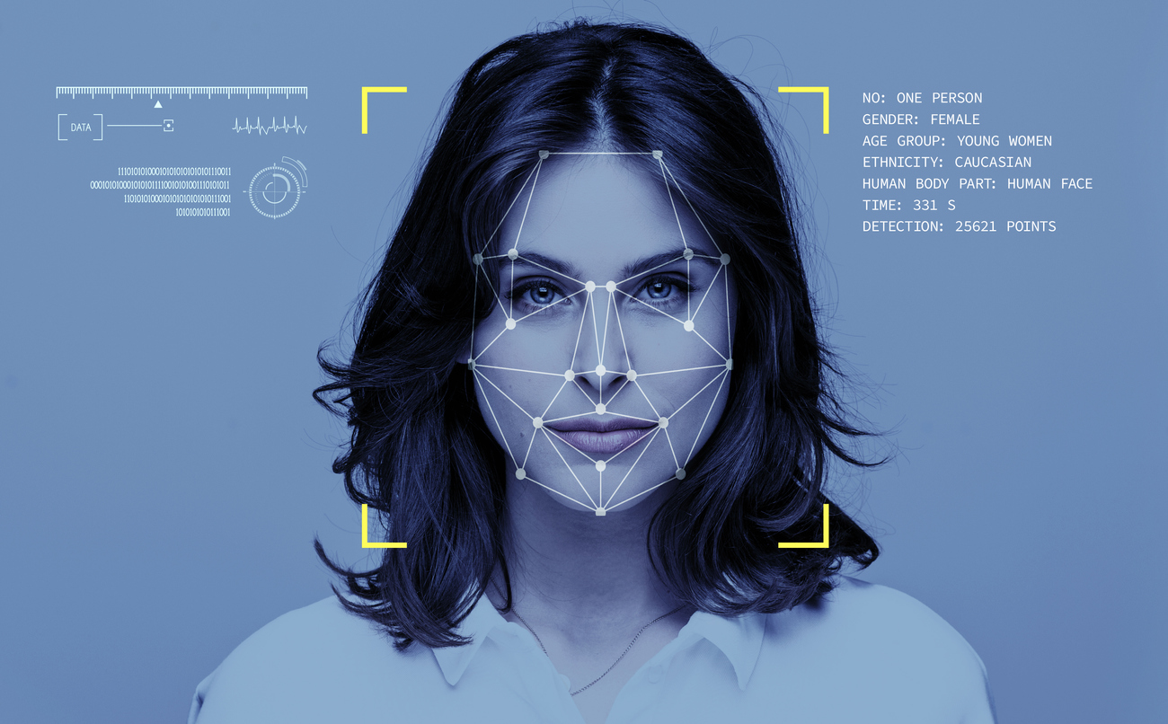

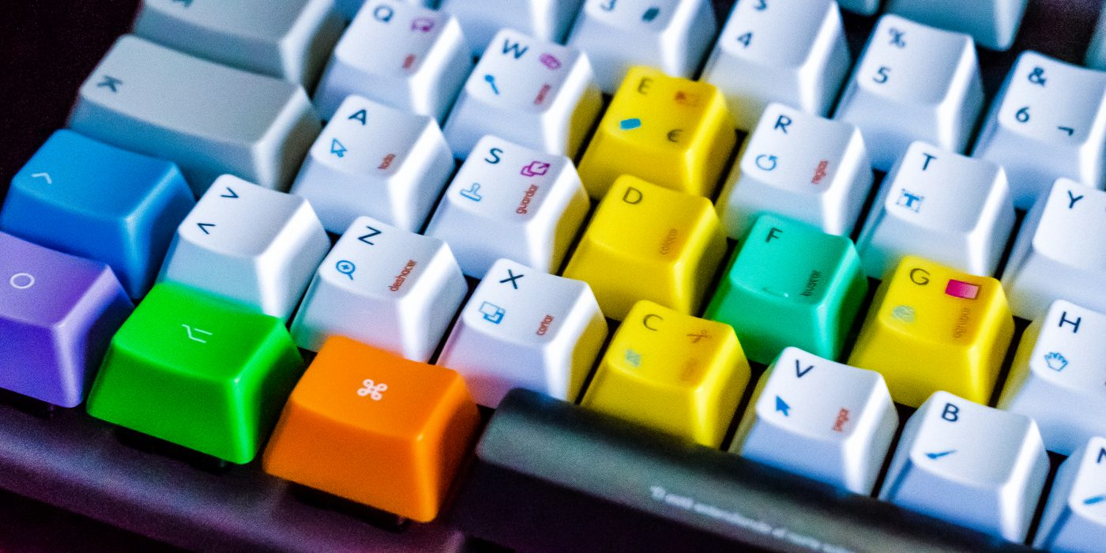
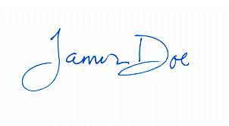
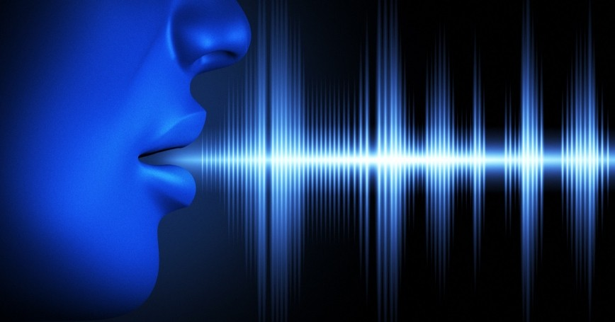
TYPES OF BIOMETRICS
Fingerprint
Hand
Iris
Face
DNA
PHYSIOLOGICAL
BEHAVIOURAL
Keystroke
Signature
Voice

Slide 7

SOLUTIONS
Biometrics refers to the automatic identification of a person based on his physiological/behavioral characteristics. Various types of biometric systems are being used for real time identification most popular are based on face recognition and finger print matching.
Fingerprints are completely unique to every individual person due to environmental factors that affect their development inside the womb. So we can use this plus point in our banking safety and security.
Most of the ATM in the past have been using ID cards to identify users but with the wide acceptance of Biometrics a new generation of Biometrics ATM are being deployed for wide range of applications worldwide.

Slide 8
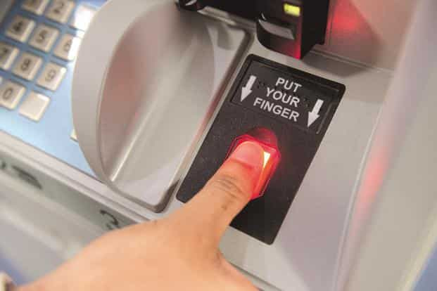
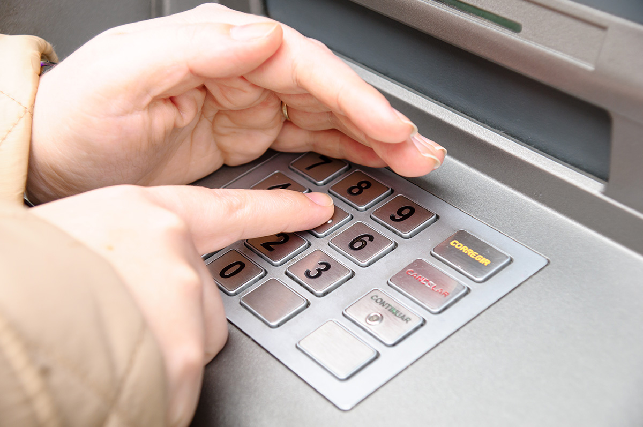
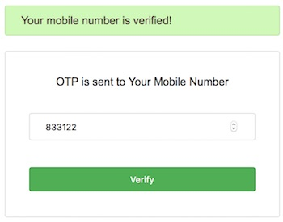
OUR IDEAS
In India, our ATM process is not secure properly. So we want to make this process more secure. We divide the ATM process security in 3 step after entering the ATM card.
IT can also be called “Three-times Authenticating ATM Process”
Fingerprint Authentication :
At first the user person have to check his/her fingerprint is matched or not with the registered fingerprint.
PIN Number Authentication :
Then the user person have to check his/her Card PIN number is matched or not with the registered PIN number.
OTP Authentication :
At last an OTP will be shared to user person and he/she have to verify the OTP in ATM machine. An OTP will only be effective for one minute.

Slide 9
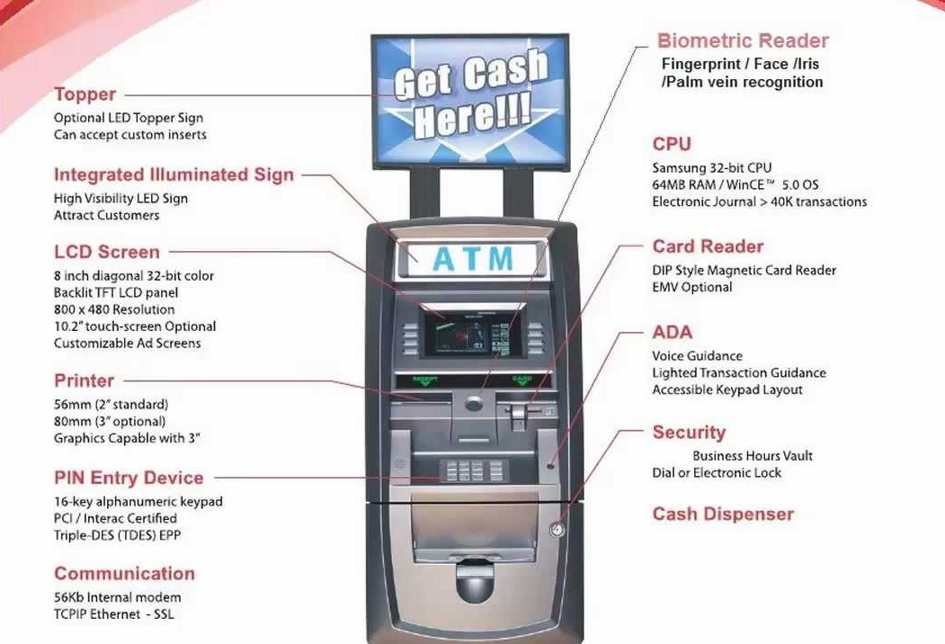

Slide 10
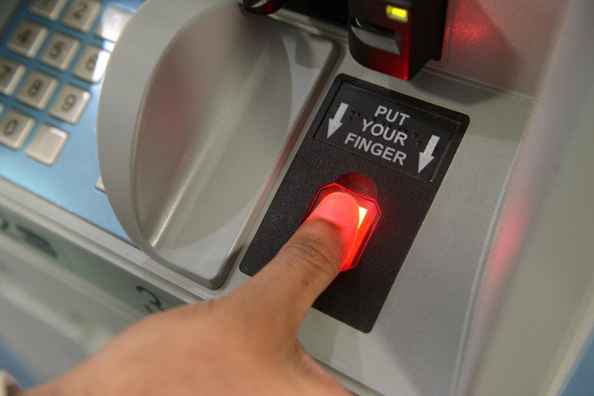
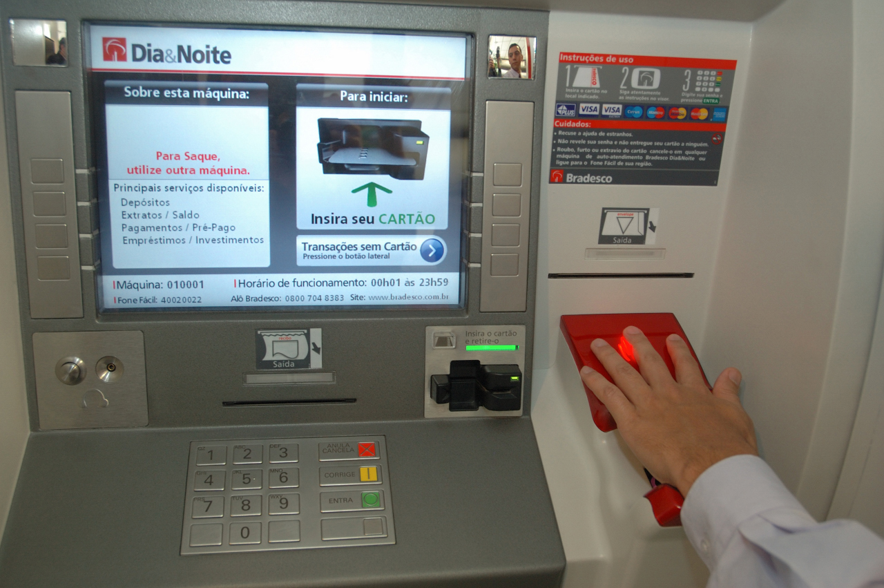
Fingerprint based ATM Machine

Slide 11
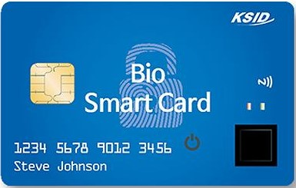
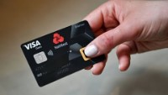
Fingerprint based ATM Card
This is a type of model of fingerprint based ATM card. It is our future idea about secure online or offline shopping systems.
It has some advantages :
In offline shopping system when we use swipe machine, there pin authentication is only the security system. Now if we use this alternative card of the current card, it will be more secure process because there will be fingerprint authentication also. It is also applicable for online shopping system.
The card owner only can use this card.

Slide 12

ENTER YOUR CARD
WORKING PROCEDURE
(FLOW CHART)
ENTER THE AMOUNT OF CASH
VALID
NOT VALID
WARNING MESSAGE WILL BE SHOWN ON THE SCREEN
SCAN YOUR FINGERPRINT
3 TIMES
MATCHED
NOT MATCHED
TRY AGAIN
AFTER 3 TIMES MISMATCHED
END
ENTER CARD PIN
3 TIMES
DANGER NOTIFICATION AUTOMATICALLY SEND TO THE BANK AUTHORITY
MATCHED
NOT MATCHED
TRY AGAIN
END
ENTER THE OTP
AFTER 3 TIMES MISMATCHED
DANGER NOTIFICATION AUTOMATICALLY SEND TO THE BANK AUTHORITY
IF PASSED ONE MINUTE
MATCHED
NOT MATCHED
OTP INVALID
PROCESS SUCCESSFULL
3 TIMES
RESEND
CASH WILL COME OUT
END
PUT THE OTP AGAIN
END
AFTER 3 TIMES MISMATCHED
DANGER NOTIFICATION AUTOMATICALLY SEND TO THE BANK AUTHORITY

Slide 13
STEP 1 : Enter your Card.
A
STEP 2 : IF Card is valid
go to STEP 3.
ELSE
go to STEP 12
PRINT WARNING massage.
STEP 3 : Enter the amount of CASH.
L
STEP 4 : Scan your Fingerprint.
STEP 5 : IF Fingerprint is Matched
go to STEP 6.
ELSE
PRINT Fingerprint isn’t Matched.
FOR count = 0 to 3
repeat STEP 4 and STEP 5.
IF count ==3
go to STEP 12
send a warning massage to Bank Authority.
[END of IF]
[END of FOR]
[END of ELSE]
G
STEP 6 : Enter the PIN of your CARD.
O
STEP 7 : IF PIN Number is Matched
go to STEP 8.
ELSE
PRINT PIN Number isn’t Matched.
FOR count = 0 to 3
repeat STEP 6 and STEP 7.

Slide 14
R
IF count ==3
go to STEP 12
send a warning massage to Bank Authority.
[END of IF]
[END of FOR]
[END of ELSE]
I
STEP 8 : A OTP will be generated and it will be send to your register mobile number through SMS.
STEP 9 : Enter the OTP.
STEP 10 : IF ONE Minute passed
PRINT OTP is Invalid.
Repeat STEP 8 and STEP 9.
ELSE
IF OTP is Matched
go to STEP 11.
ELSE
FOR count = 0 to 3
Repeat STEP 8, STEP 9 and STEP 10.
IF count == 3
go to STEP 12
send a warning massage to Bank Authority.
[END of IF]
[END of FOR]
[END of ELSE]
[END of ELSE]
T
H
M
STEP 11 : The CASH will be come out.
STEP 12 : EXIT

Slide 15

Business Concept
Our project is almost a new concept in our country India. Punjab National Bank had already released a type of biometric ATM in Delhi and CSB also unveiled in Kerala. Now we are doing this project under our university TIU. So at first our project needs to be verified by the authority of our university. It is a bank related project. So we have to take Government permission to release this project practically. Financial help from government or any other source is very necessary. We Should contact with both Government and Private Banks to explain the opportunities of this ATM system. But we are just working on the software base of this project. We don’t know how much it will cost to make this project a success. So now this is impossible to decide any price range for sale. We will update our business idea properly in later.

Slide 16

Target Customers
WE will target the General Public who are faced ATM card frauds and other ATM related issues.
We will target both Government Banks and Private Banks.
We will target different types of shops and business places.
We will target offices who need a safe money transfer process.

Slide 17

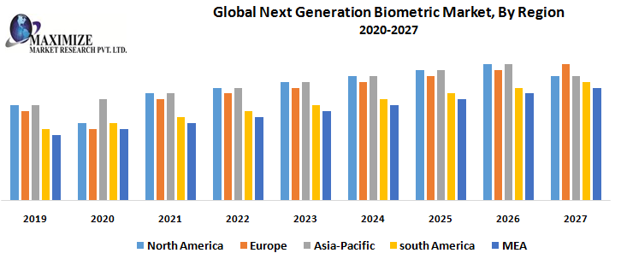
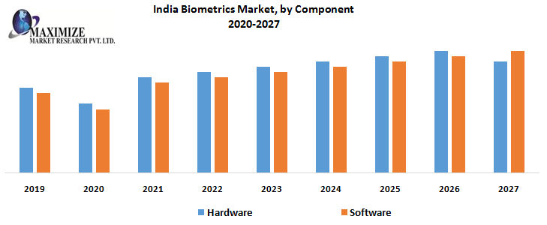
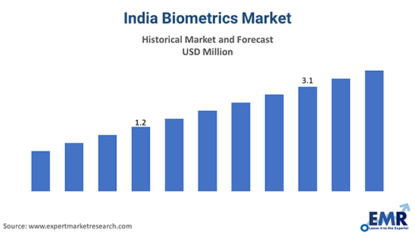
Market Summary

Slide 18

Stakeholders Map
Partners
(Team Members)
Govt. Bank / Private Bank
Biometric ATM Project
Investors
Government
Businessmen, Officers & Common Publics
Supporters / Advisers

Slide 19
OUR
We are thinking about Biometric (Fingerprint) ATM card which can be used in ATM machine as well as various stores, shopping mall and businesses as a secure money transfer process. So it is a very unique process in our state as well as in our country.
So we can assume that if people will use this system they will feel more secure and they will be able to do fearless money transfer.
U
nique
S
elling
P
oint

Slide 20
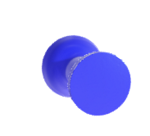


STRENGTH
OPPORTUNITY
SWOT ANALYSIS
WEAKNESS
THREATS

Slide 21


STRENGTH
Easy usage process
There is three step authentication process. So it is a highly secured way of banking
While a criminal be able to obtain a password illegally, getting a user’s fingerprint would be much more complicated
WEAKNESS
It is a project which can only be implemented if funds are high enough
Hacking of Database or fingerprint templates.

Slide 22


OPPORTUNITIES
Biometric ATM machine is a system that works with biometric traits to identify customers and allow them to withdraw cash.
The driving “push” factor for biometric ATM adoption is that biometric technology shortens transaction time. It also provides security unlike other measures in common use. Using biometrics can deter crimes like Internet banking fraud, money laundering, and identity theft
THREATS
Some organization has already started their work procedure on this project. So it is very challenging to us to make our project idea best

Slide 23

CONCLUSIONS
Biometric tokens are the safest means of preventing ATM frauds.
The main reason for introducing biometric system is to increase overall security.
In this semester we developed the algorithm and the flowchart for the require program to run the machine. Actually we work on the software system and want to make it more stable.
Now……….
We have to think about the machine structures and its system and how we can link the software and the hardware systems of this machine properly.
We also have to make a dynamic program on this algorithm for processing the system
We will work on that topics in next semesters.

Slide 24

THANK YOU

